Slide 1
House Price Prediction
By:
Abhishek (2101130140003)

Slide 2


Slide 3
Introduction
House is one of the basic needs for a person and their prices vary from place to place depending on available amenities like parking place, locality, no_of_sqft, bath, bhk etc.
Buying a home is one of the biggest and most important choices for a family as they put all of their funds into investment and cover them over time with loans.
In this project, we will implement a Bangalore House Price Prediction model using a Machine Learning Algorithm (Multiple Linear Regression) using Python Language.
This model predicts the price of Bangalore’s house with the help of few parameters like availability, size, total square feet, bath, location etc.
Our model can be used by both house sellers and house buyers.

Slide 4
For a user, employing a House Price system is one of the ways to reach the house price information that interests him. Bengaluru House price dataset is used to create the model. We are using Machine Learning Algorithm to create a predictive model. Multiple Linear Regression Algorithm is used to train and test the model in our project and predict the House price. Python is widely used for Movie Recommendation system.

Slide 5
Abstract
House Price forecasting is an important topic of real estate. The literature attempts to derive useful knowledge from historical data of property market.
Machine learning techniques are applied to analyze historical property transaction in India (Bangaluru) to discover useful models for house buyers and seller.
Revealed is the high discrepancy between house prices in the most expensive and most affordable suburbs in the city of Bangaluru.
Moreover, experiments demonstrate that the Multiple Linear Regression that is based on mean squared error measurement is a competitive approach.

Slide 6
Purpose of a recommendation system
Having a house price prediction model can be a very important tool for both seller and the buyer as it can aid them in making well informed decision-
There is a user viewpoint here: to easily and quickly find information of House Price in Bangulure save user’s time.
There is a viewpoint of the owner of the House : For seller it may help them to determine the average price at which they should put their house for sale .

Slide 7
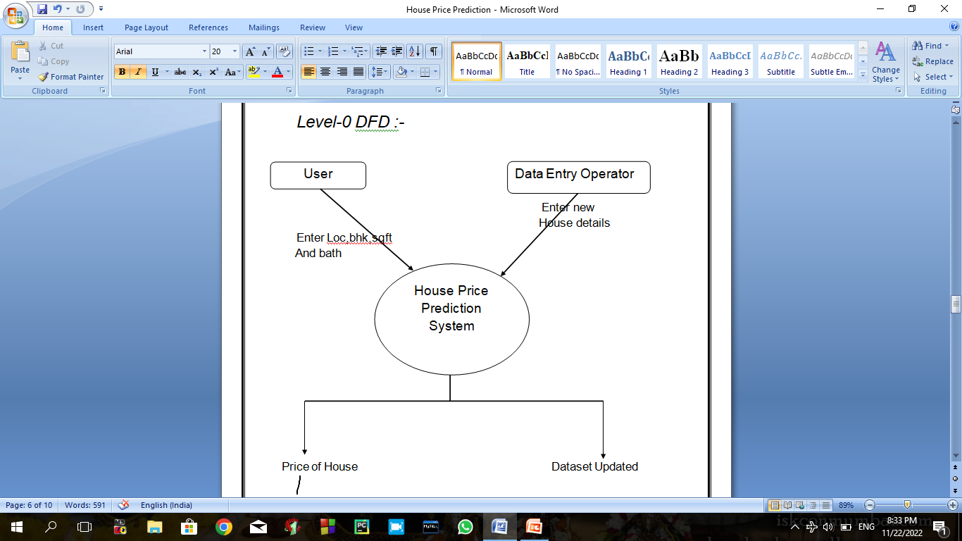
Data Flow Diagram (DFD)

Slide 8
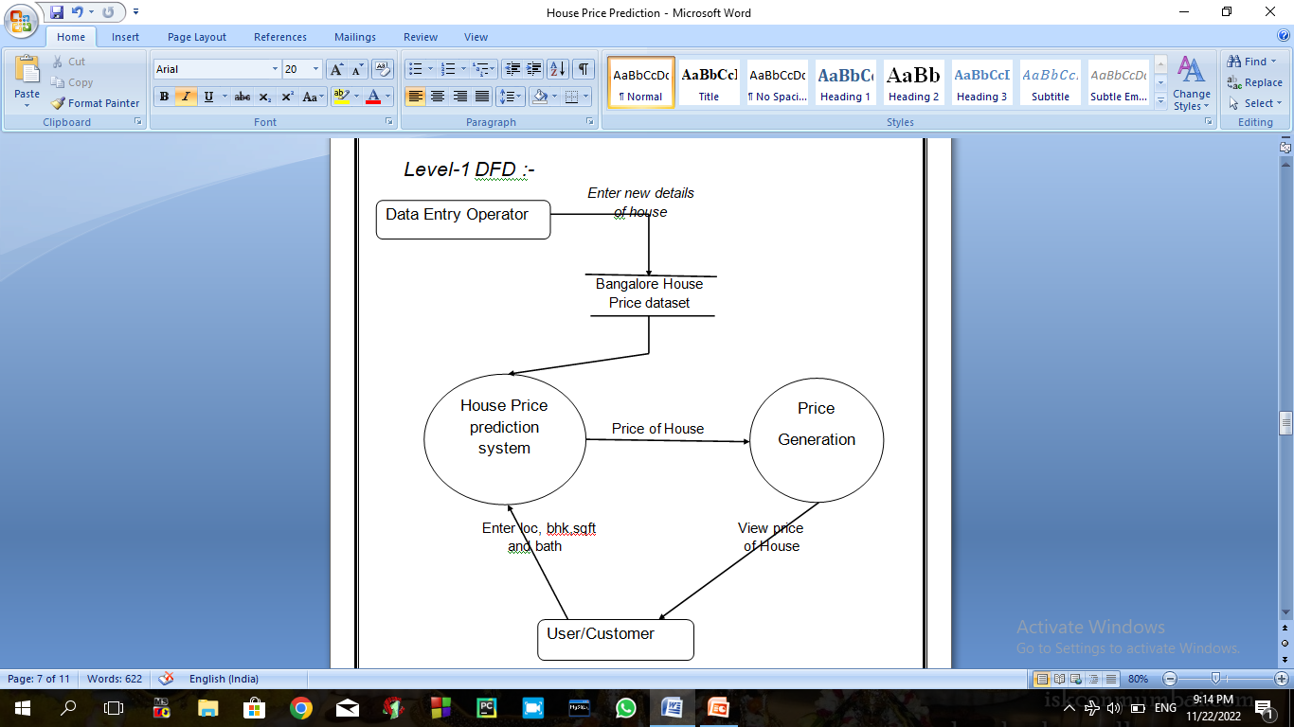
Level-1 DFD :-

Slide 9
SYSTEM SOFTWARE REQUIREMENT SPECIFICATION (SRS)
Below are the requirements used for running House Price Prediction
System Requirement
Command for installing Jupyter Notebook:- pip install jupyterlab
Windows-Based Requirements
Dual-core 64-bit processor
8 GB of memory
Up to 24 GB of internal storage ( Jupyter Notebook: 2.5GB+1GB for caches,)
Windows 10, Windows 8.1 Update, Windows 8, and Windows 7.1

Slide 10
Library Requirements for House Price Prediction System
Pandas (Accessing and modifying Datasets)
Numpy (Creating Multidimensional array)
Matplotlib(Data Visualization )
Sklearn ( Selecting, building and testing the Multiple Linear Regression model)
Flask(For Model Deployment)

Slide 11
Future Scope and Challenges
One of the challenges while proposing an algorithm for House Price Prediction is to determine the attributes affecting the price.
As different factors affect RS differently, therefore, how to assign appropriate weights to the attributes is a major task when designing an algorithm.
In Future, the models can be upgraded with some better techniques in terms of getting higher and better accuracy.
It is, therefore, challenging to cope with the problem of changing users requirements.

Slide 12
Thank You

